Slide 1

HARCOURT BUTLER TECHNICAL UNIVERSITY
INDUSTRIAL TRAINING
Summer Internship at Sapphire Application Integrators Pvt. Ltd.

Slide 2
Prepared By
Mohit Jaisal
Roll Number: 190104041
Batch: 2019-2023 [BTech]
Branch: Computer Science & Engineering
Subject: Industrial Training [ECS-493]
Summer Trainee

Slide 3
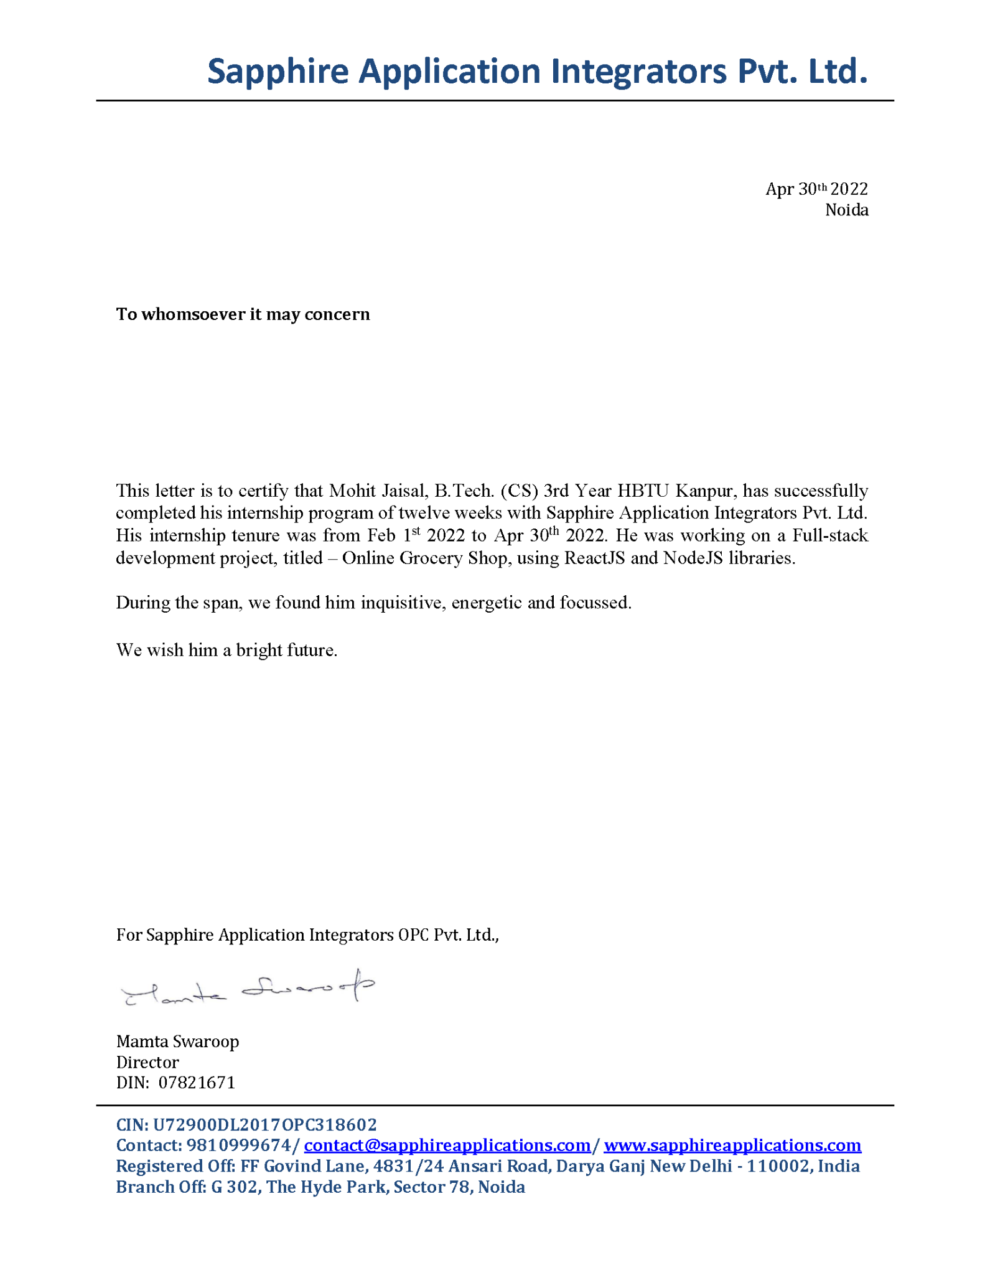
TRAINING
CERTIFICATE

Slide 4


ABOUT THE COMPANY
Sapphire Application Integrators Pvt. Ltd. partners with global organizations across different focused verticals, including Financial Services, Life Sciences & Healthcare, Telecom, Retail & Logistics, and Entertainment.
It delivers services and solutions by leveraging its deep domain capabilities, and experience in Digital Technologies, Product Engineering, and Infrastructure Services.
Sapphire Application Integrator is one of the fastest-growing software products and services companies that delivers a differentiated customer experience, accelerates cycle times, and helps customers achieve business outcomes through the adoption of new-age digital technologies and integrating them with their existing systems.
Through our customer-centric and collaborative approach, we have been able to build global delivery models which ensure predictable outcomes, reduction in cost and time while maintaining the highest software engineering quality and standards.

Slide 5

ABOUT THE PROJECT
I joined the team as a summer intern and start in the online grocery shop department.
The project was named as "Sapphire Foods". It is an online food delivery application made with React Js and Node Js with multiple features.

Slide 6
PROJECT GUIDE
Mrs Mamta Swaroop
Miss Aarohi Gupta
Sapphire Application Integrators Pvt. Ltd.
Sapphire Application Integrators Pvt. Ltd.
Director
Project Mentor

Slide 7

PROJECT TIMELINE
Start
Week 01 to 03
Learned all the required technologies which we have used in the project.
1

Slide 8
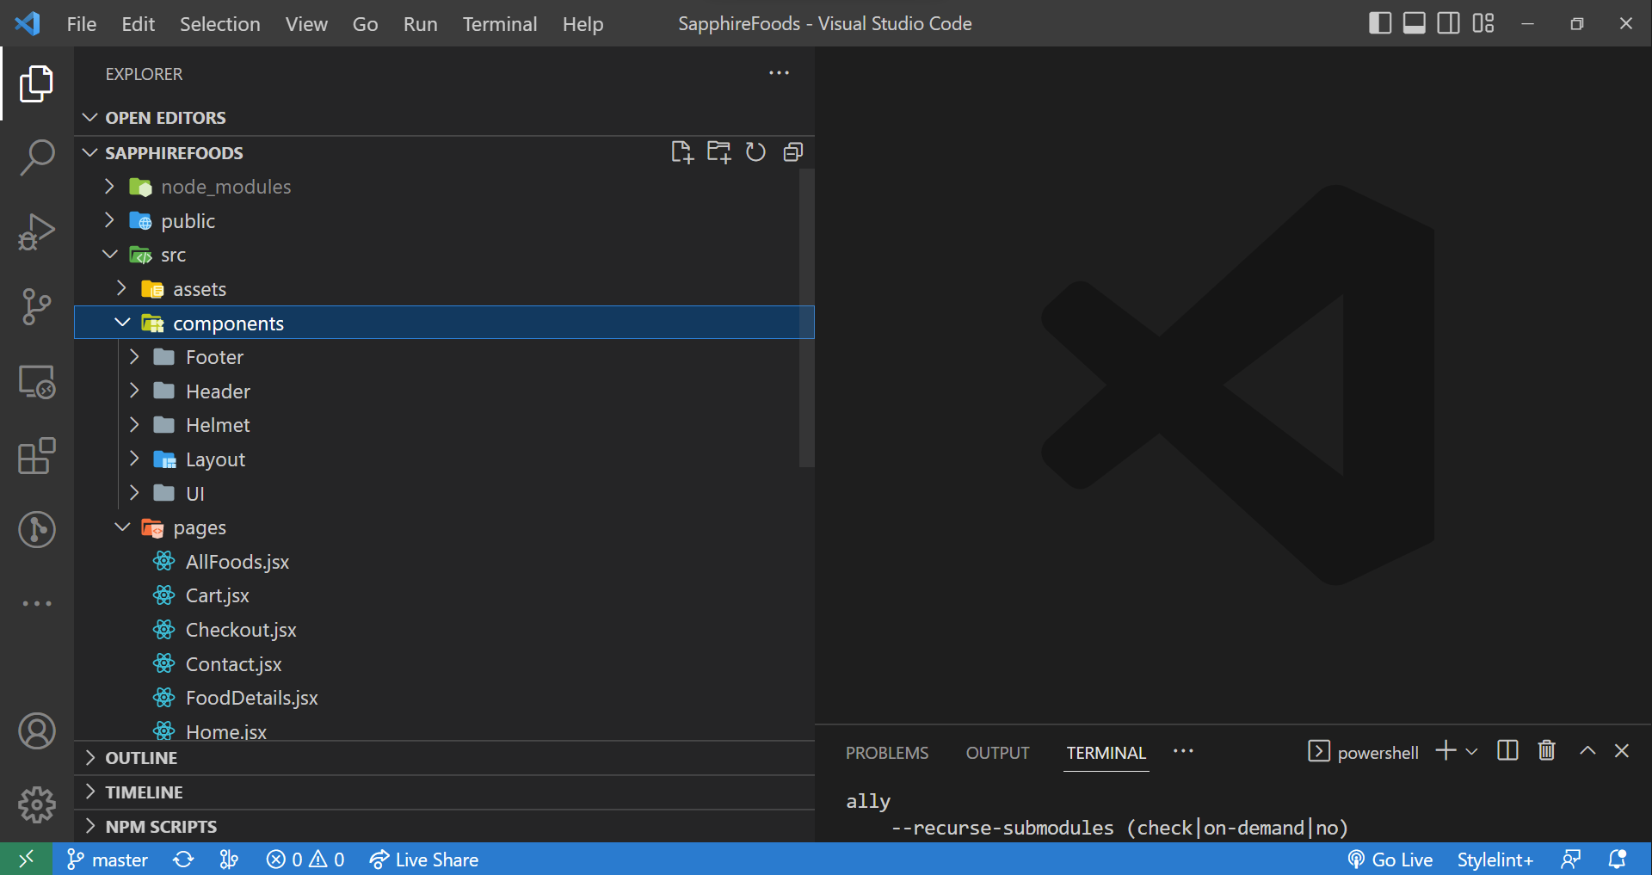
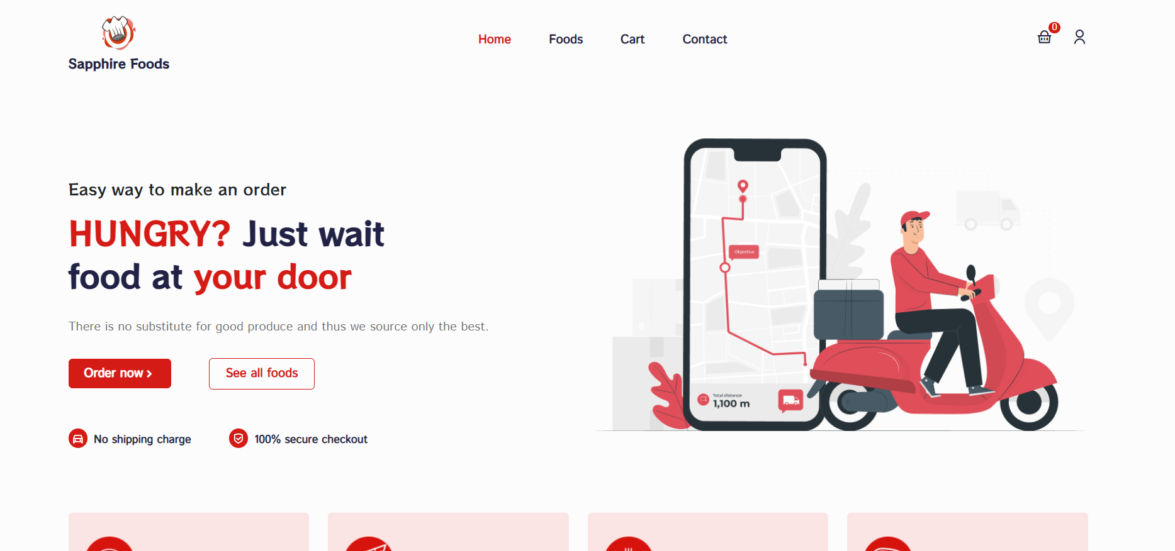
Week 04 to 06
2
Developed the basic structure of the project folder-wise and separate all the react-based components into a separate components folder.
Week 07 to 09
Executed the complete project according to the requirements and start testing.
3

Slide 9

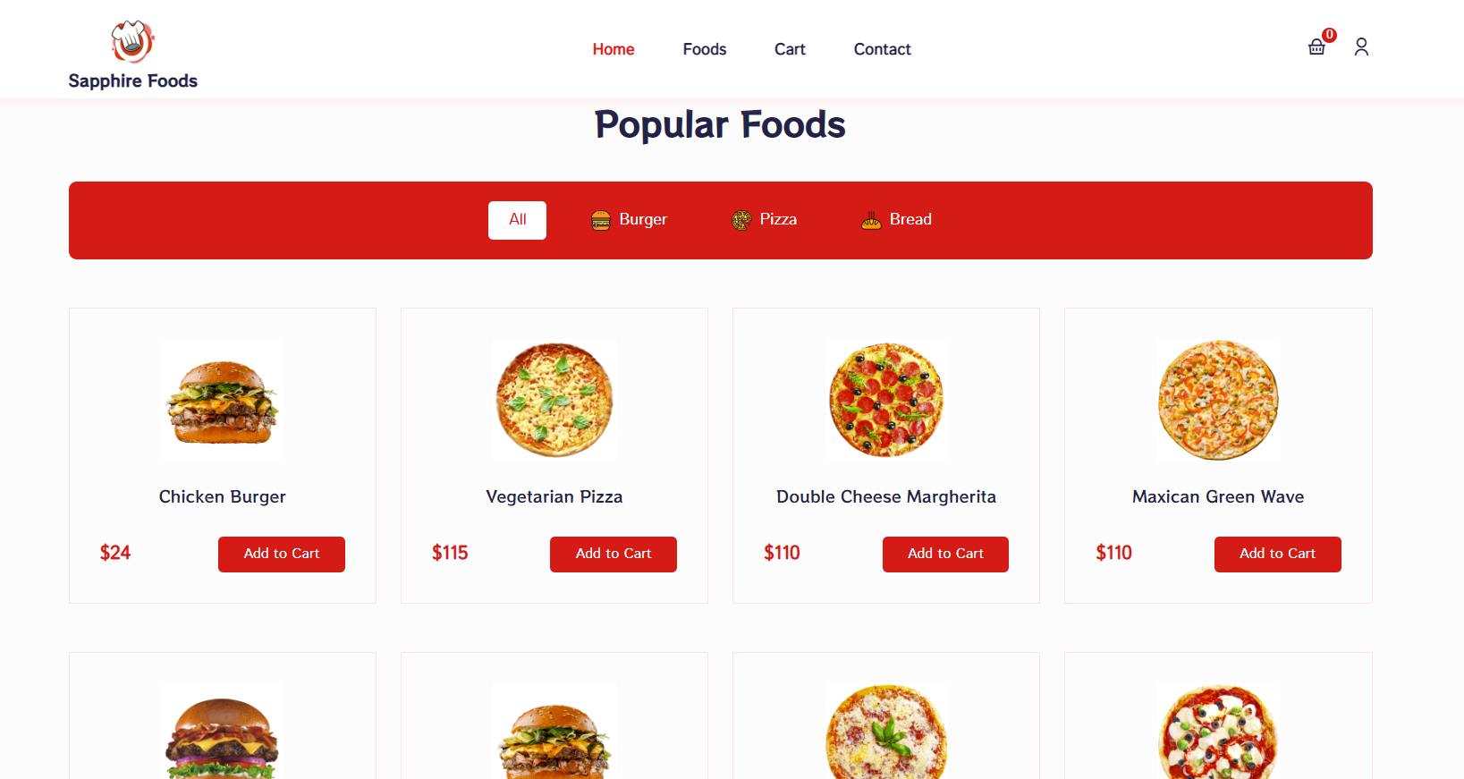
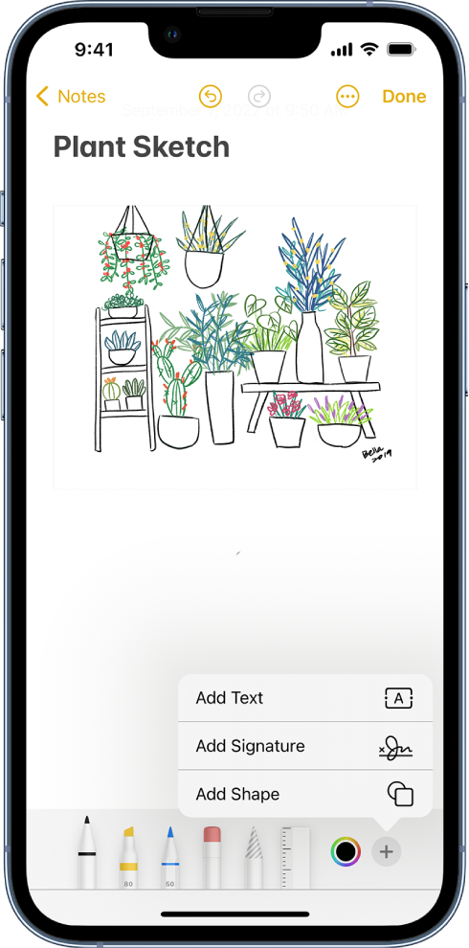
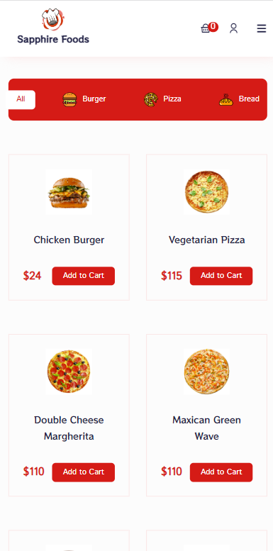
Week 10 to 12
4
Finalized the whole project resolved all the bugs and solved all the responsiveness issues for all screen sizes.
Finish

Slide 10





TECHNOLOGIES USED

Slide 11
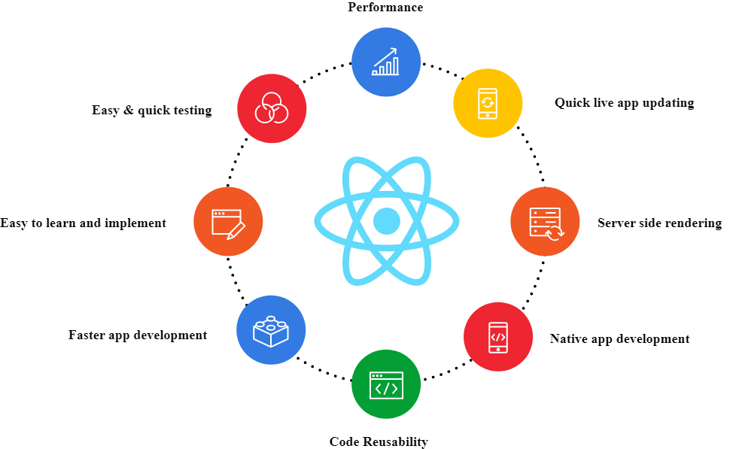
BENEFITS OF REACT JS

Slide 12
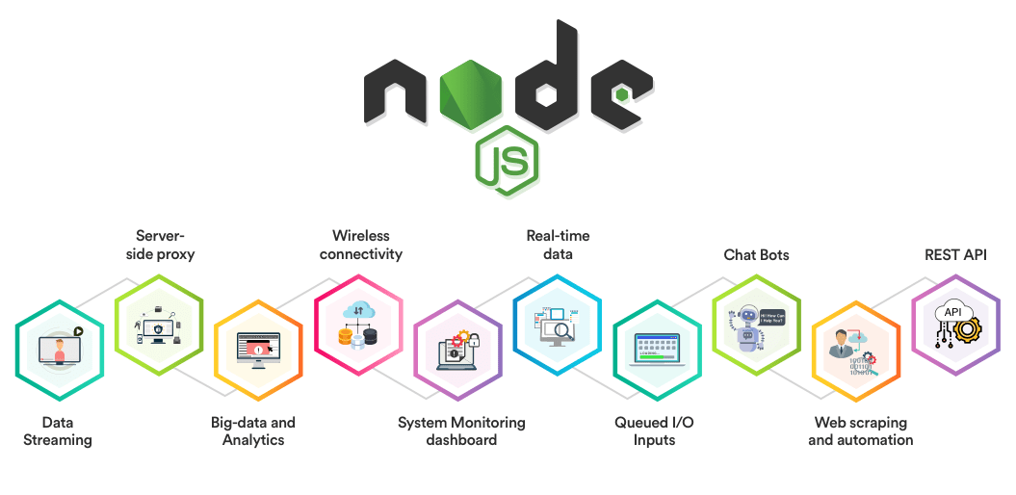
BENEFITS OF NODE JS

Slide 13
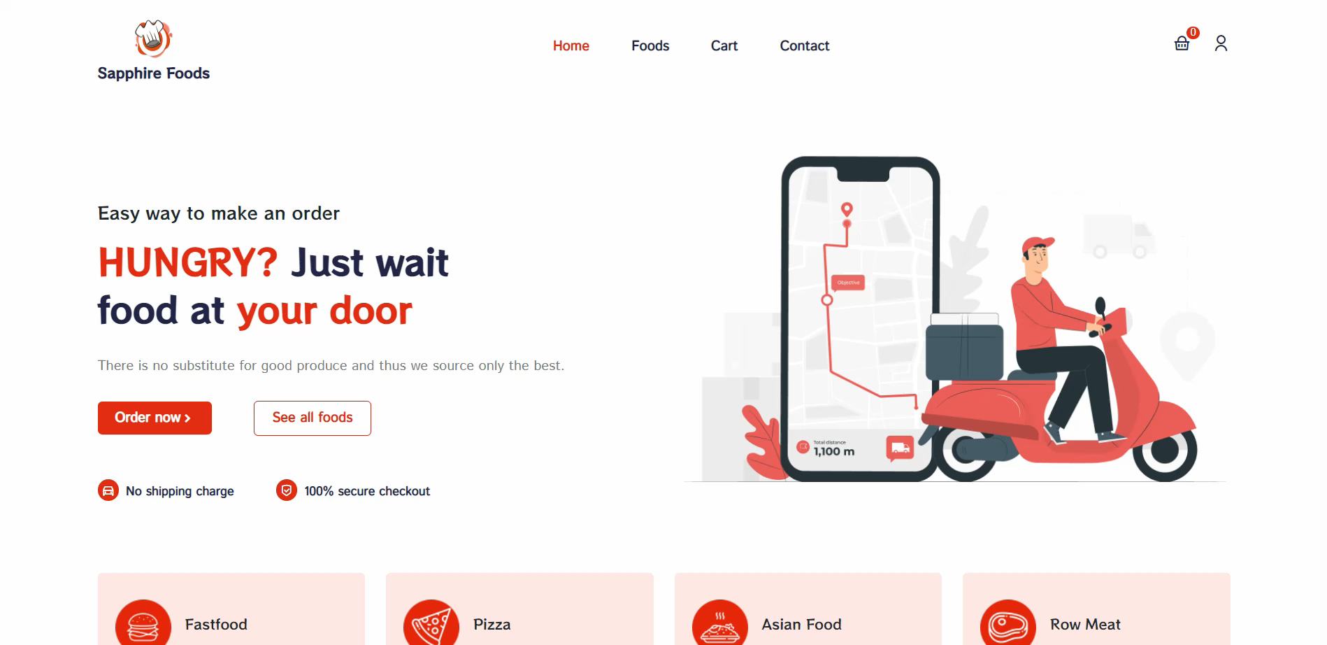
PROJECT FIRST LOOK

Slide 14
APPLICATION
FEATURES

Slide 15
FLOW CHART
Sign-Up
Popular Foods
Add to cart
Start
Home Page
Filter Foods
Cart
Checkout
End
Sign-In
Foods
Remove from cart

Slide 16
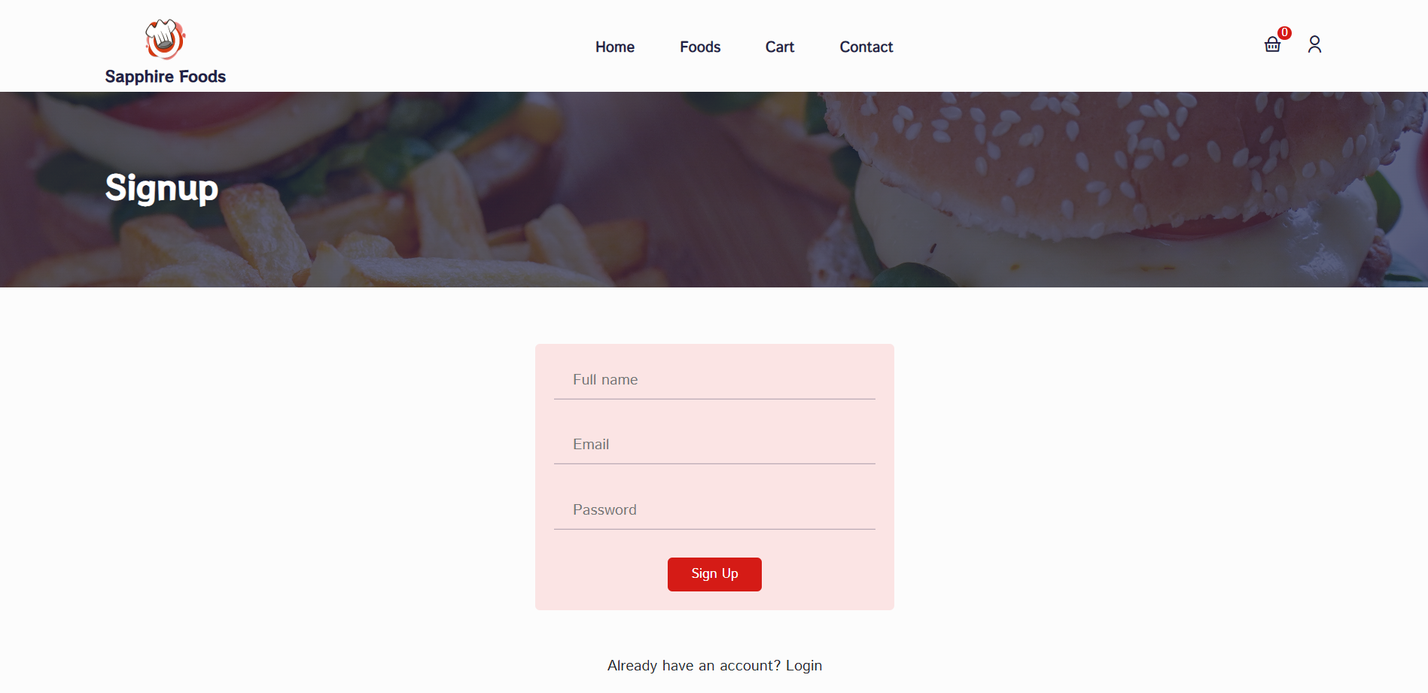
USER SIGN-UP

Slide 17
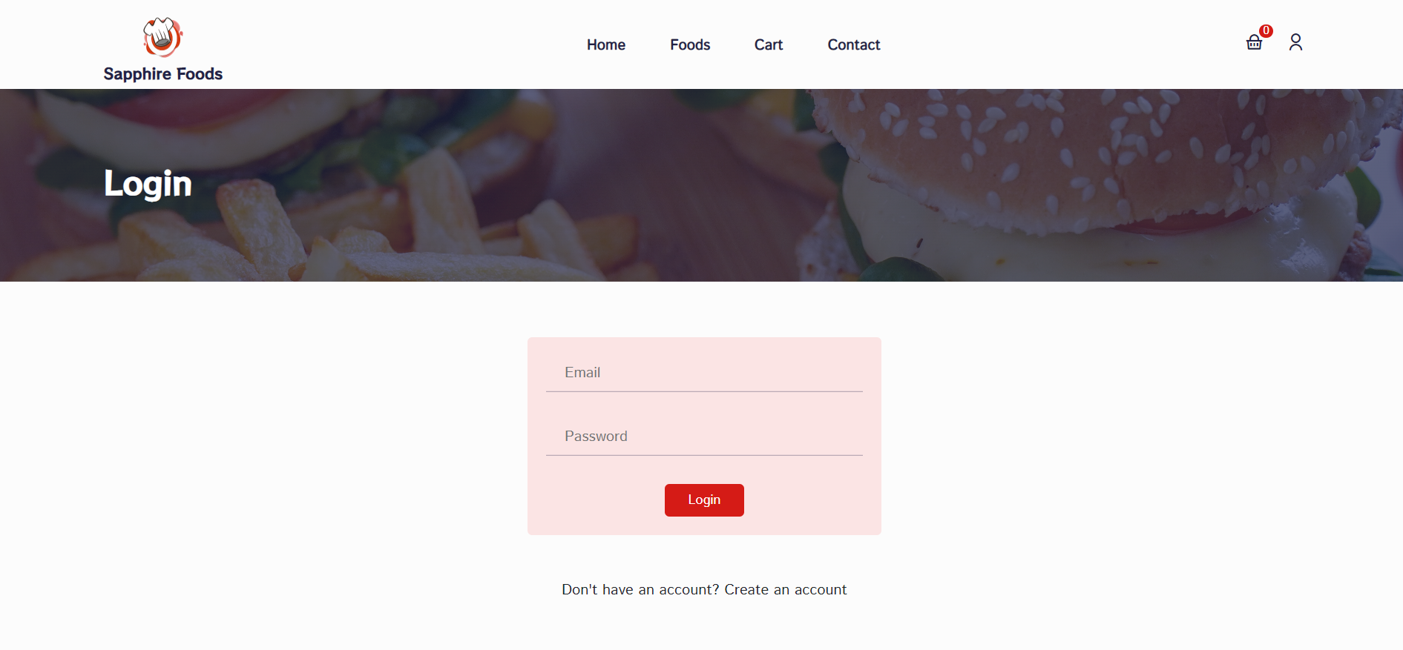
USER SIGN-IN

Slide 18
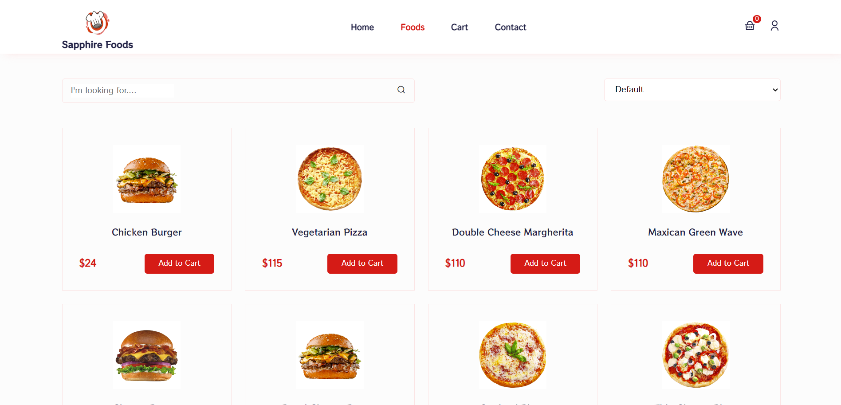
SEPARATE FOODS PAGE

Slide 19

FILTER FOODS

Slide 20
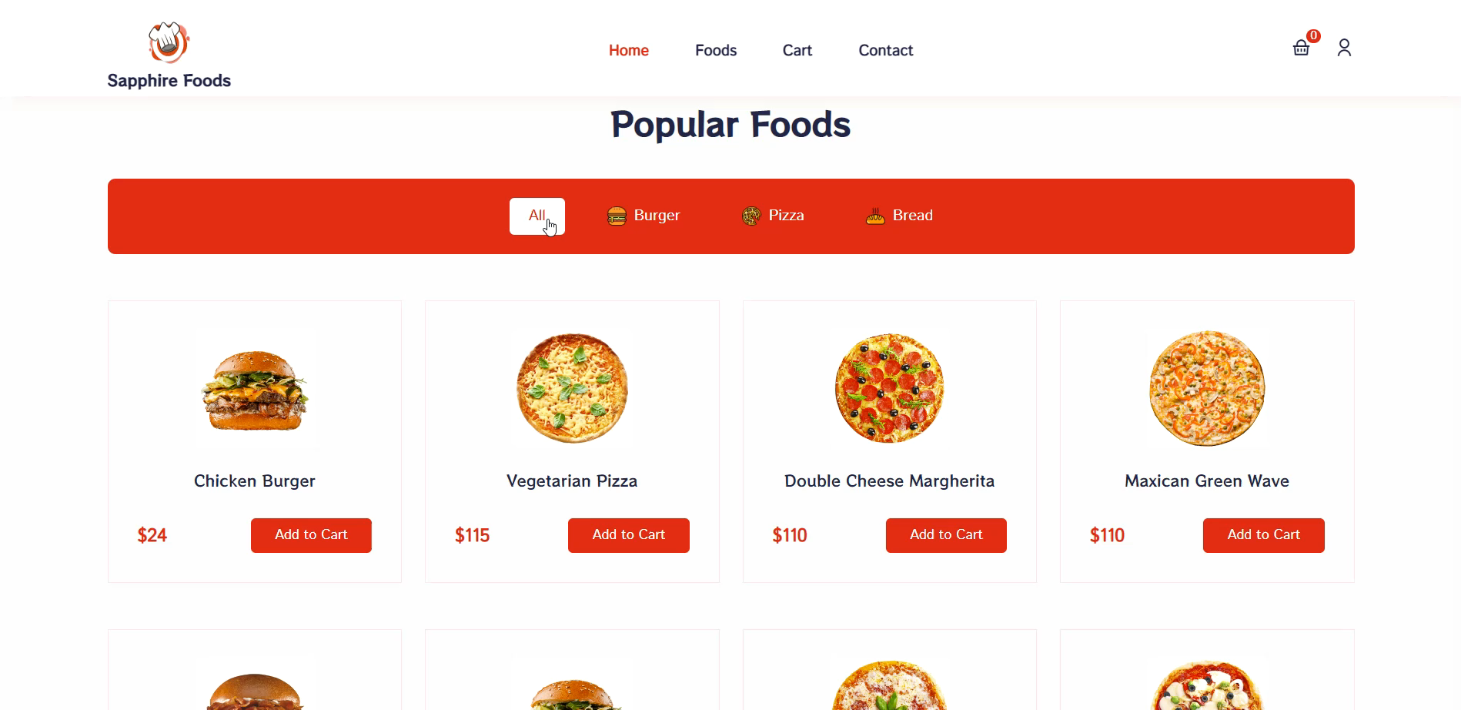
FILTER DESIGN FOR POPULAR FOODS

Slide 21
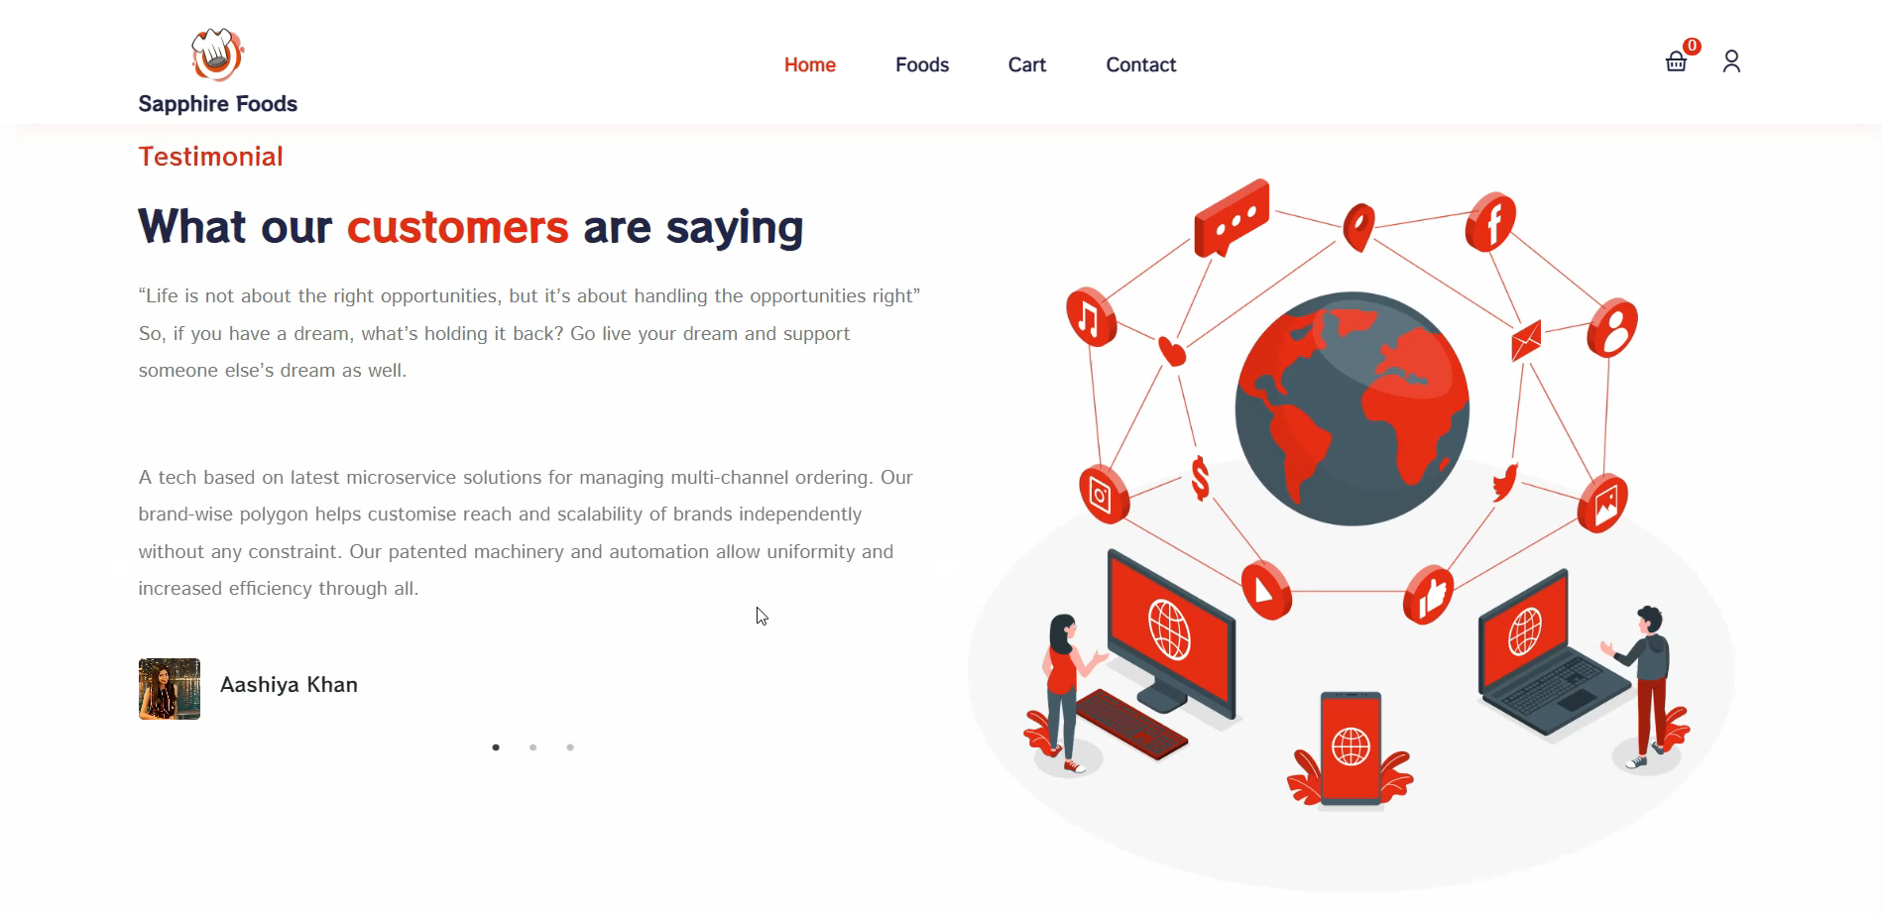
FEATURED TESTIMONIALS

Slide 22
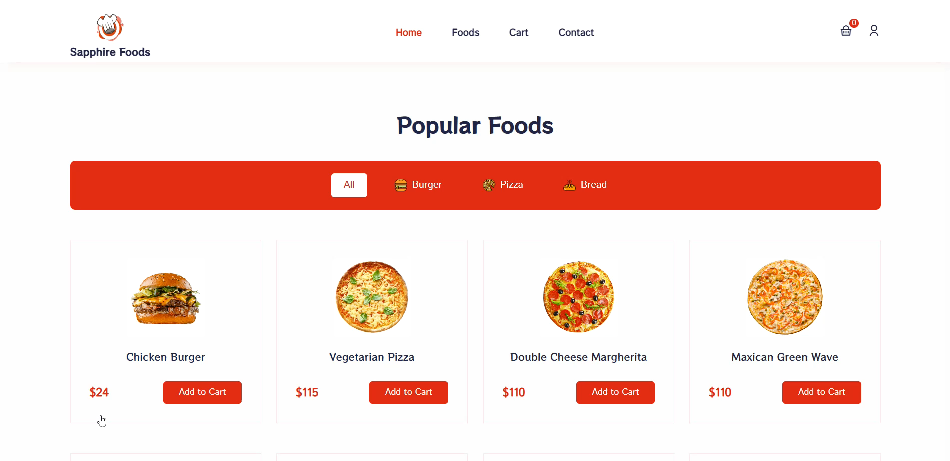
REAL TIME CART

Slide 23
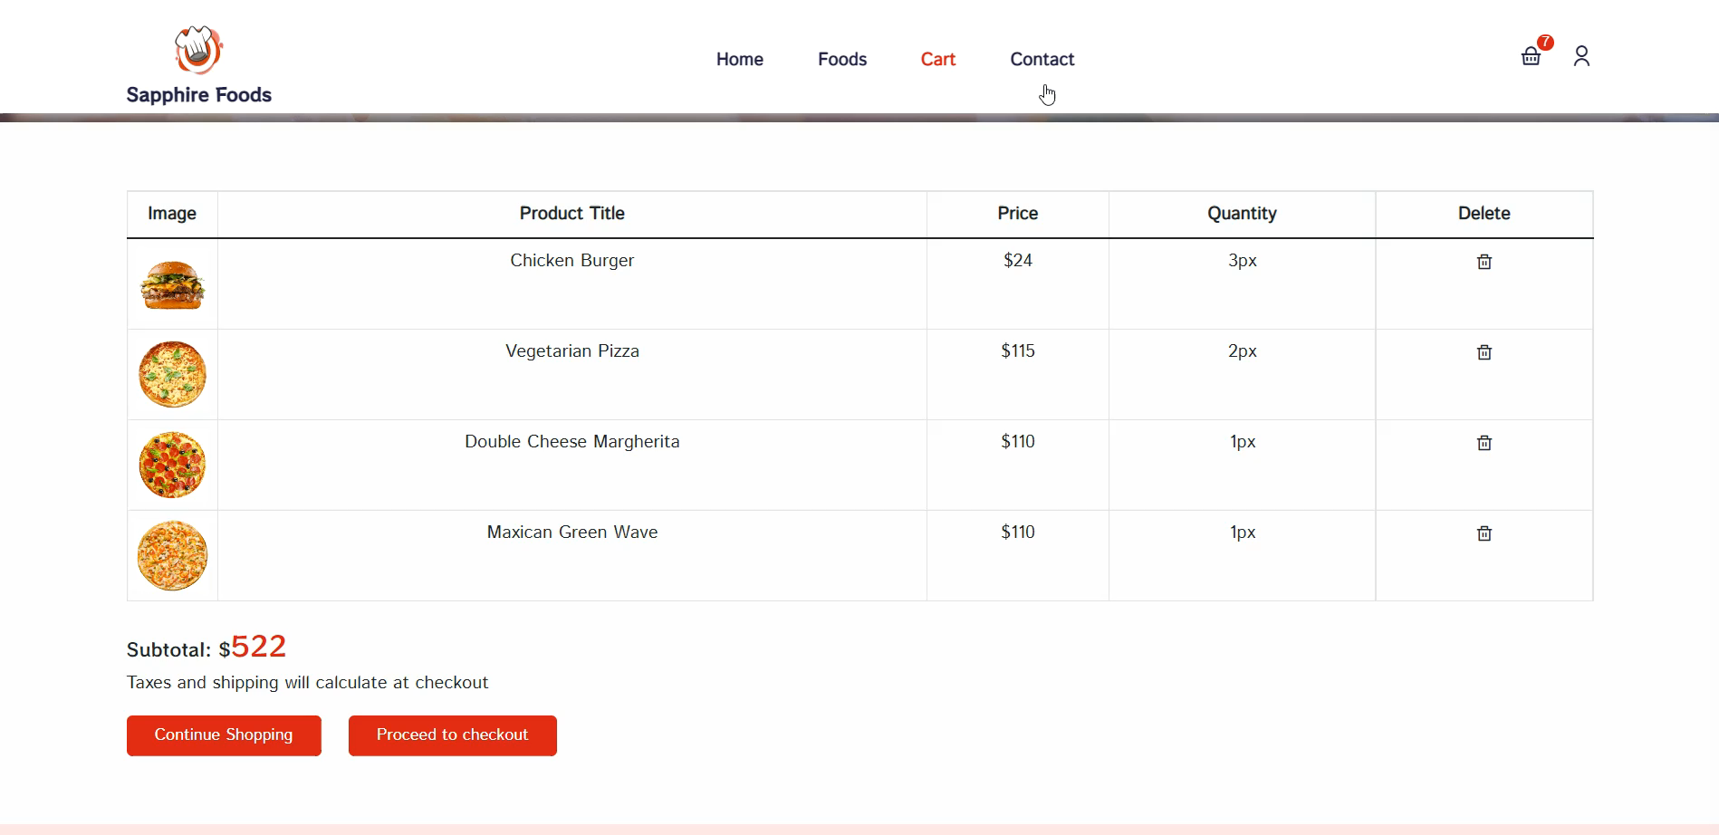
CART PAGE

Slide 24
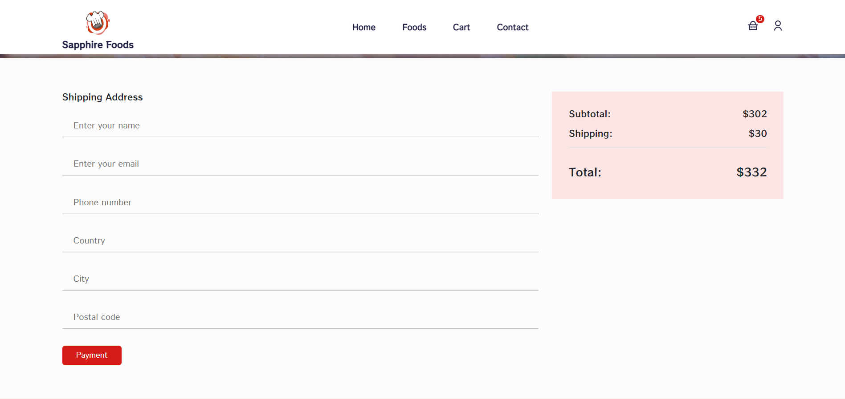
FOODS CHECKOUT

Slide 25
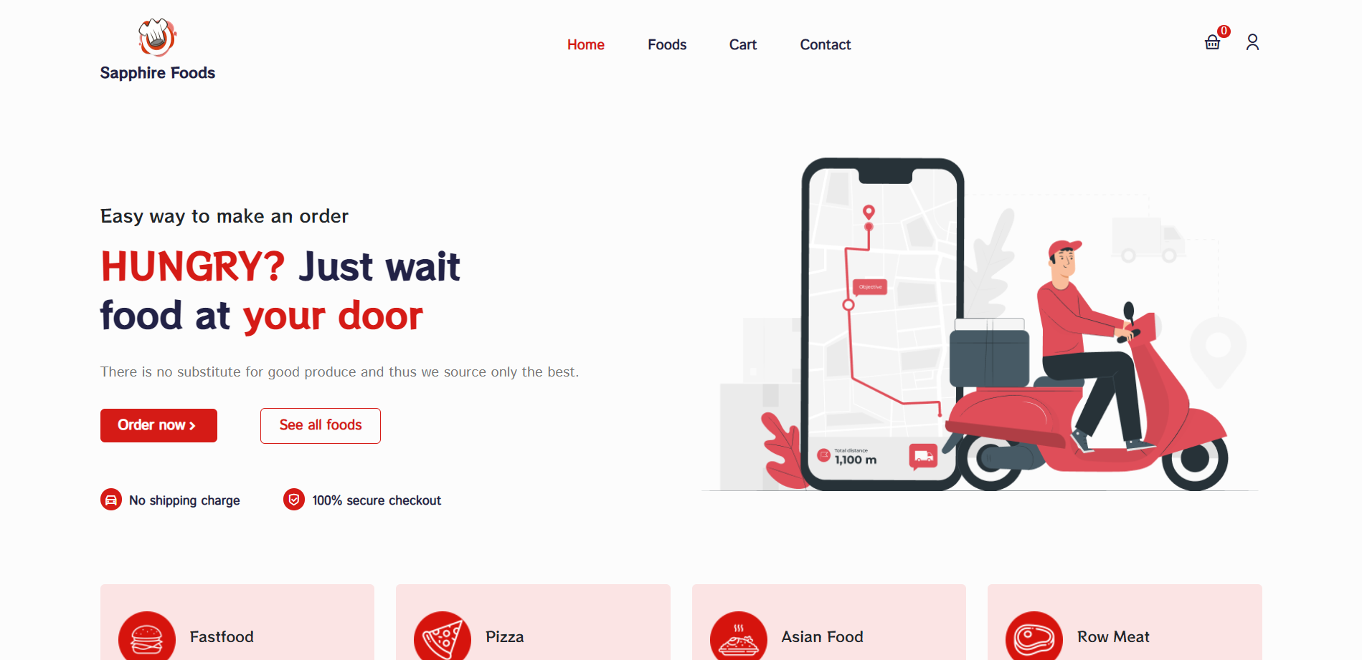
LIGHT MODE

Slide 26
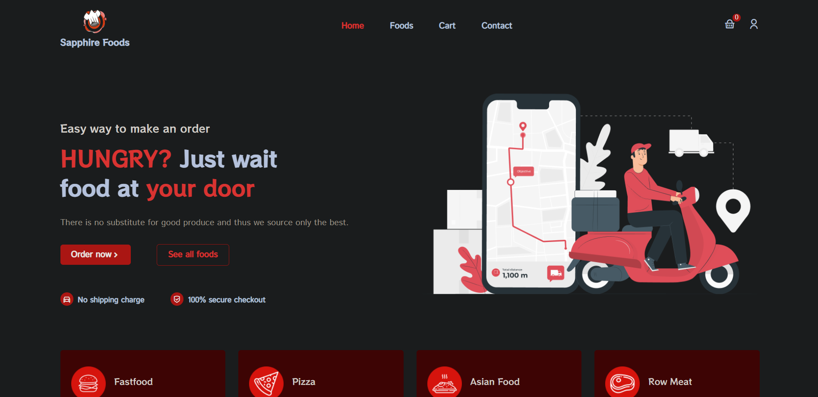
DARK MODE

Slide 27
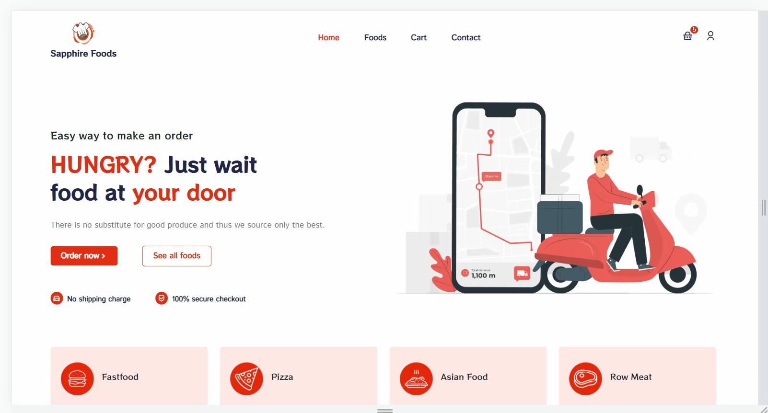
RESPONSIVE FOR ALL SCREEN SIZE

Slide 28
TECHNICAL
PART

Slide 29
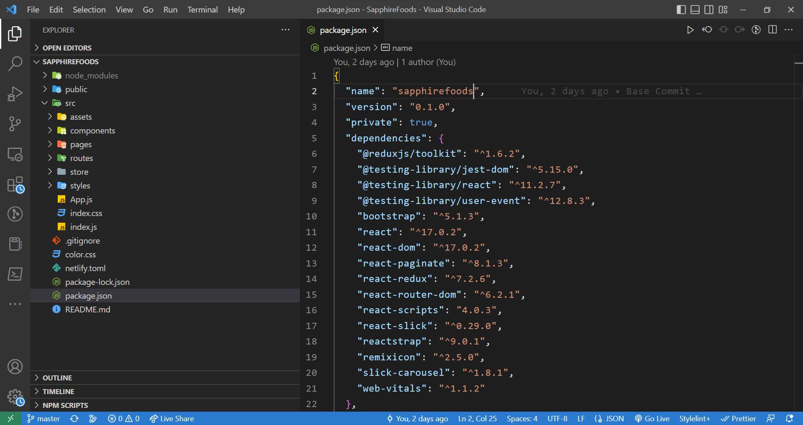
FOLDERS/FILES STRUCTURE

Slide 30
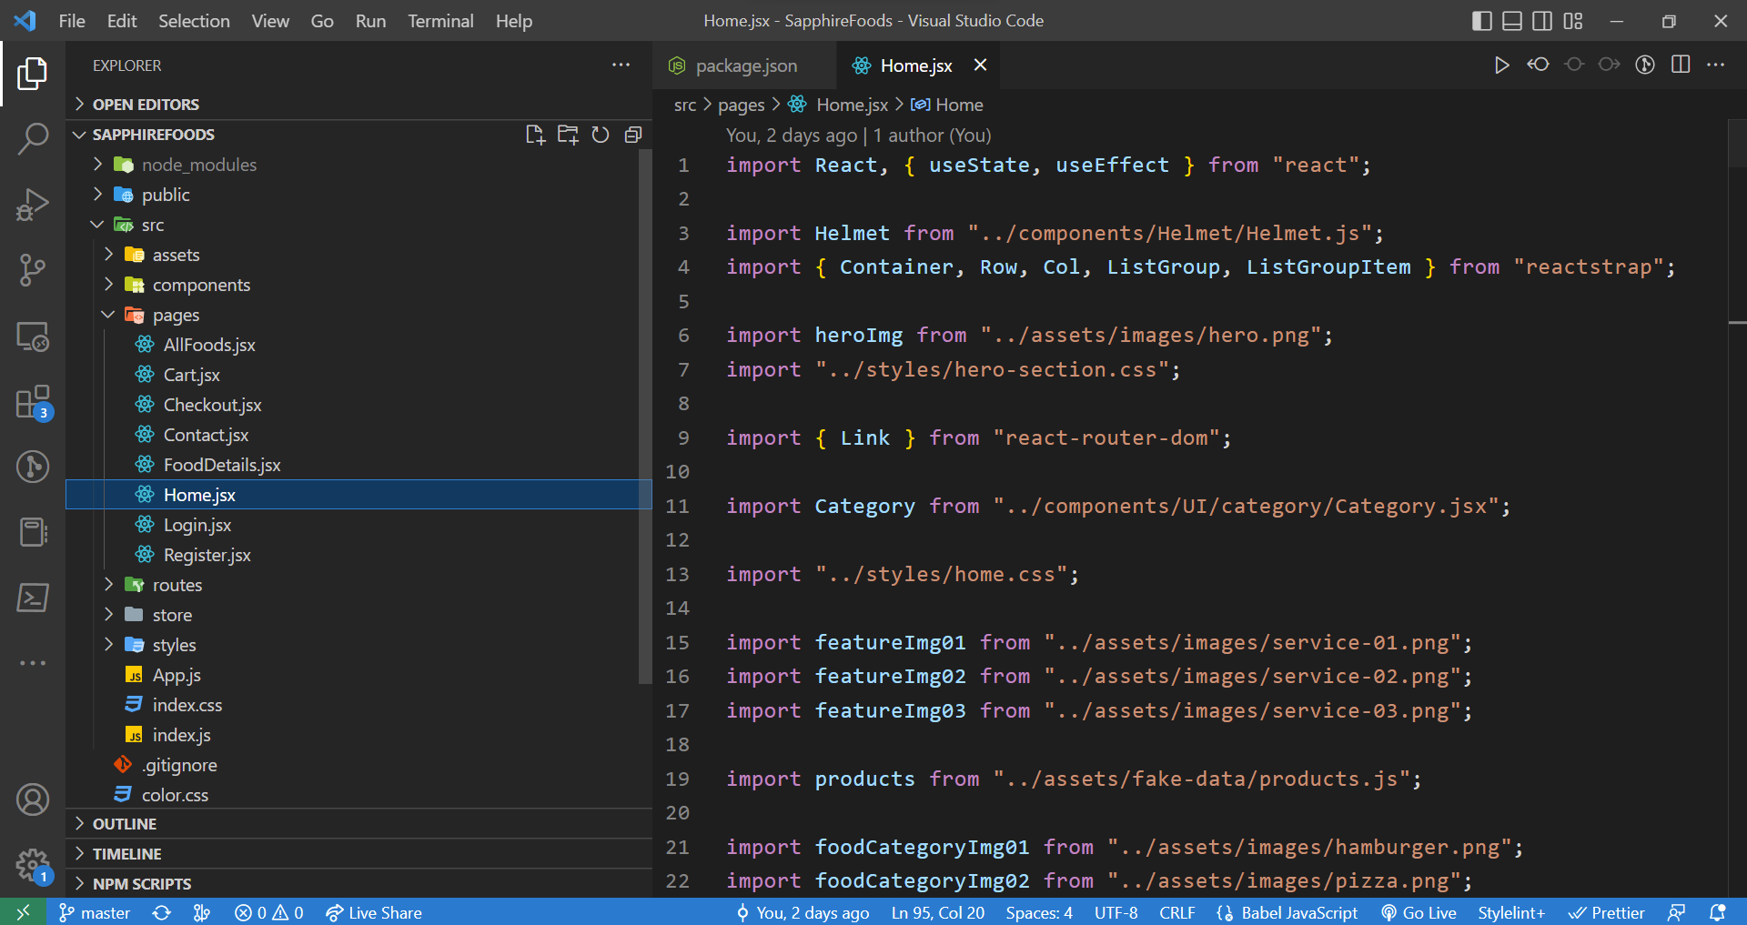
PAGES JSX

Slide 31
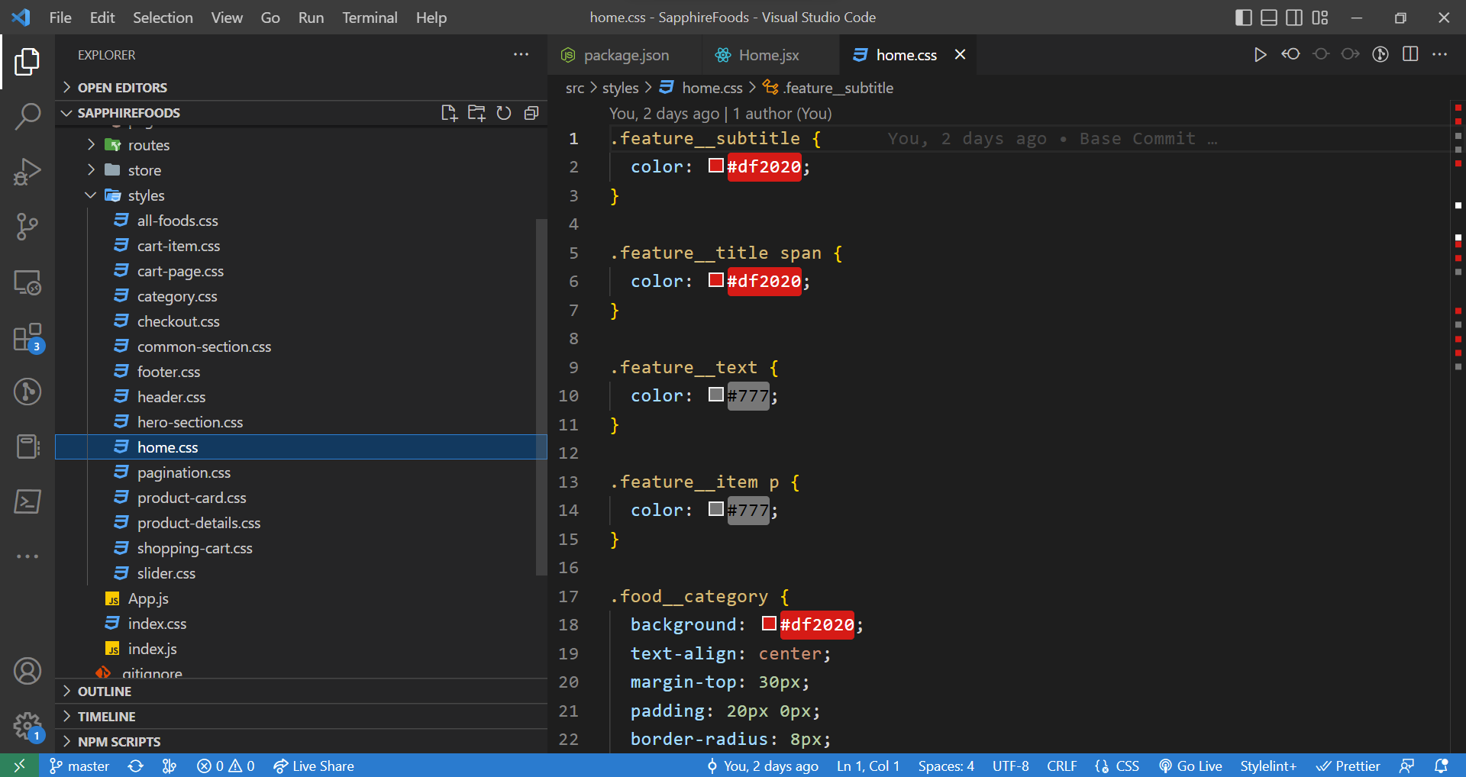
STYLES & DESIGN

Slide 32
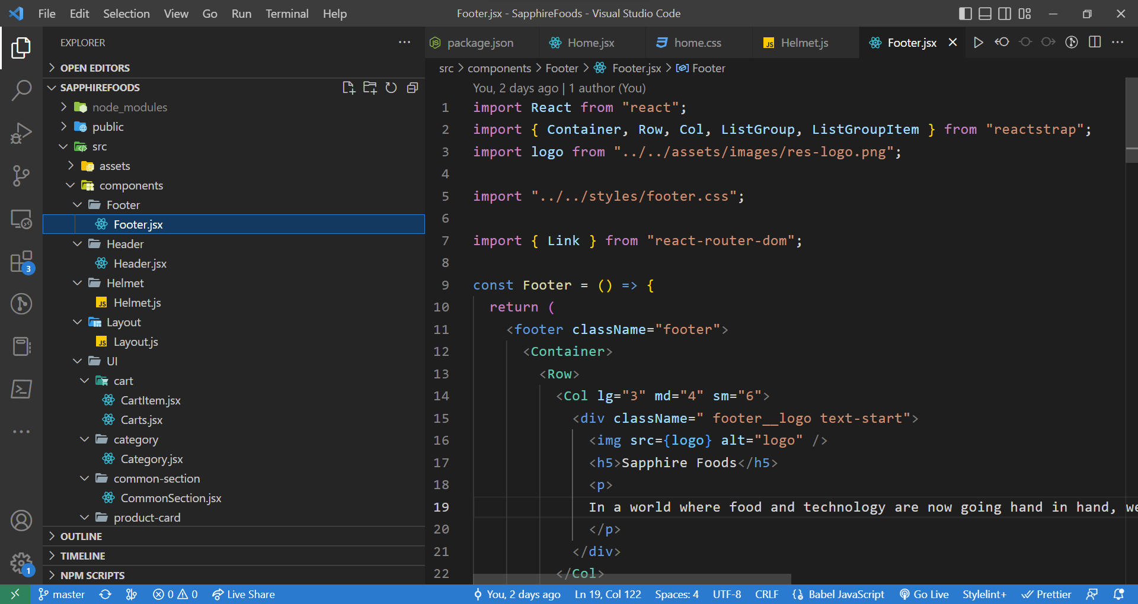
REACT COMPONENTS

Slide 33
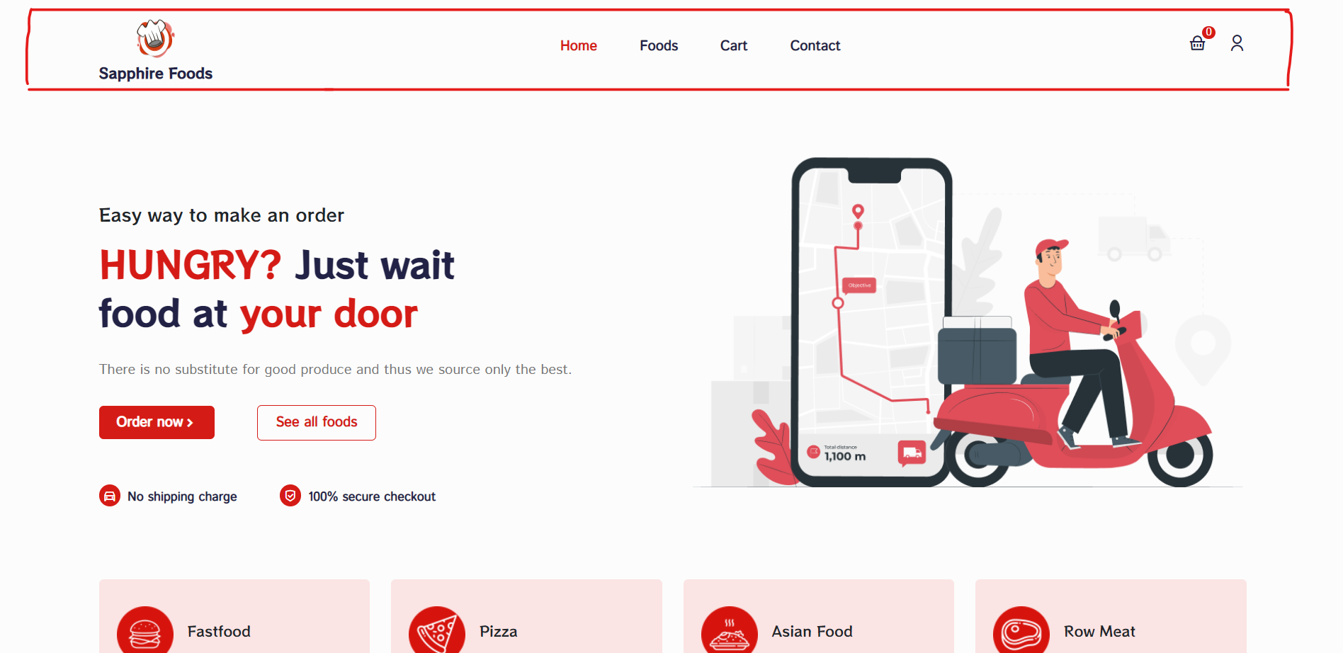
HEADER COMPONENT

Slide 34
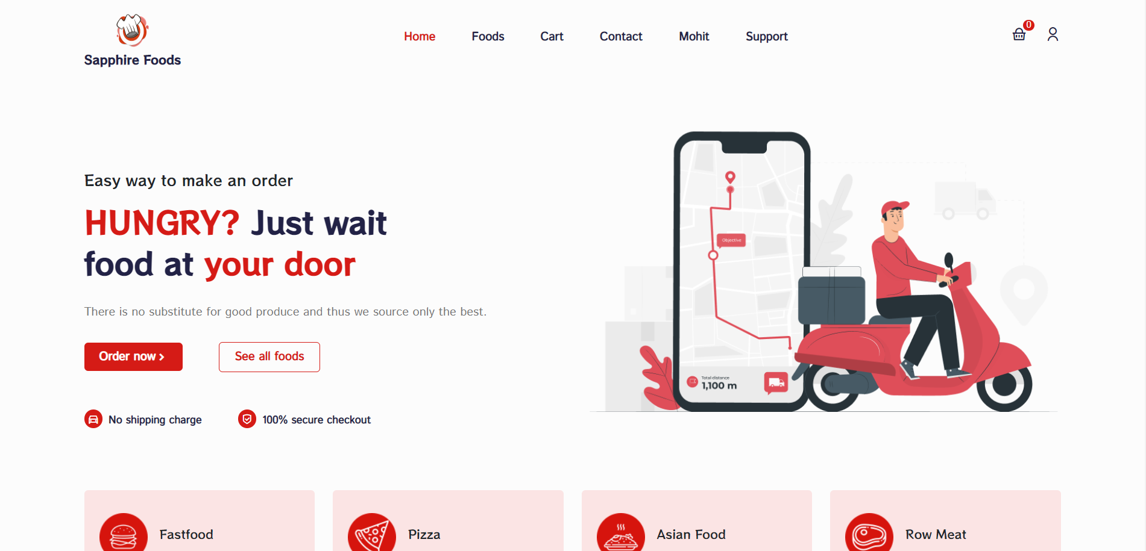
UPDATE HEADER MENU

Slide 35
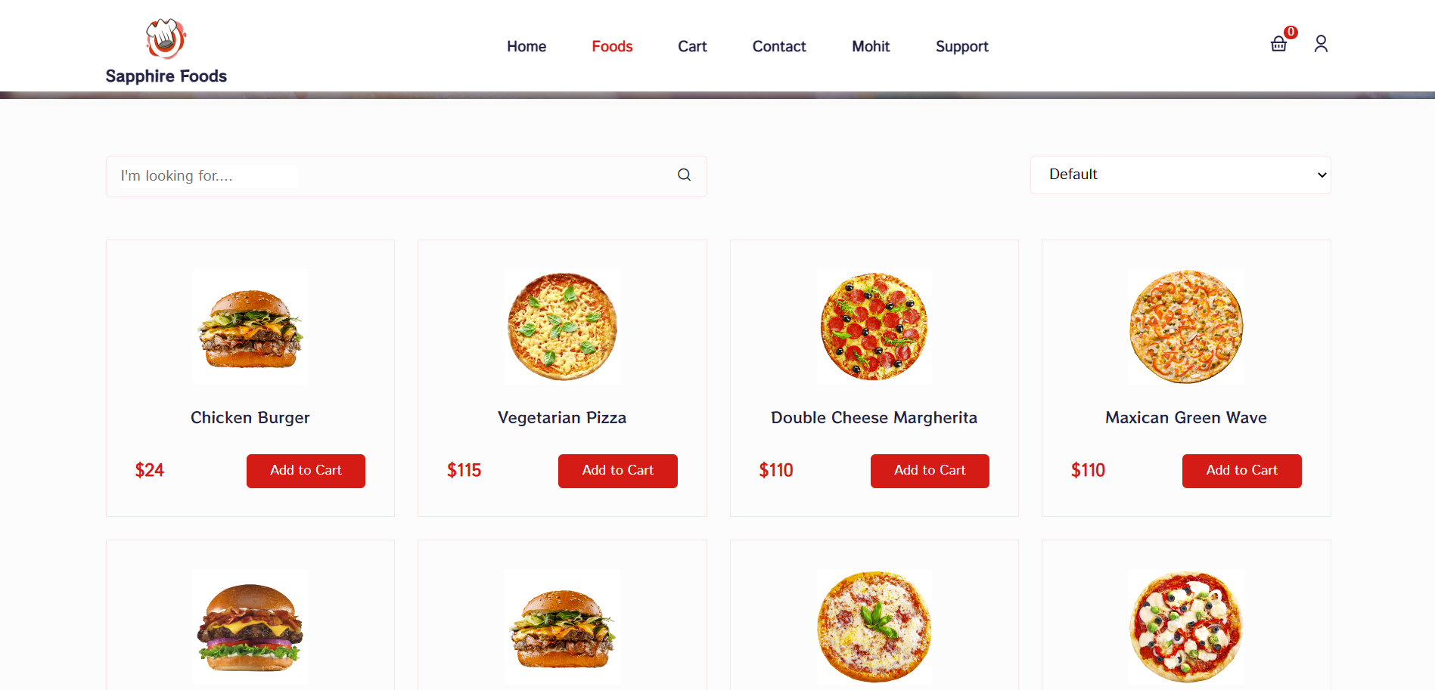
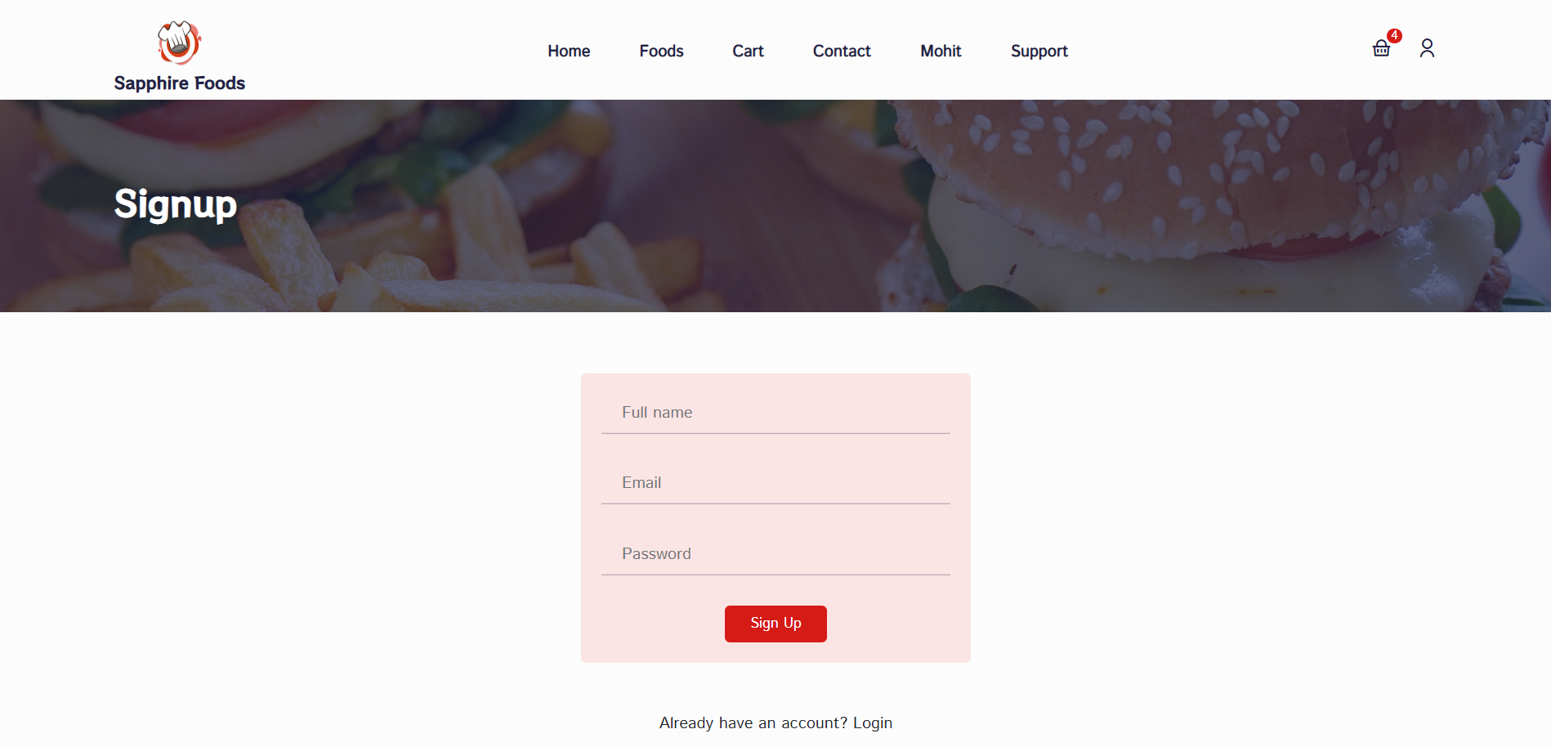
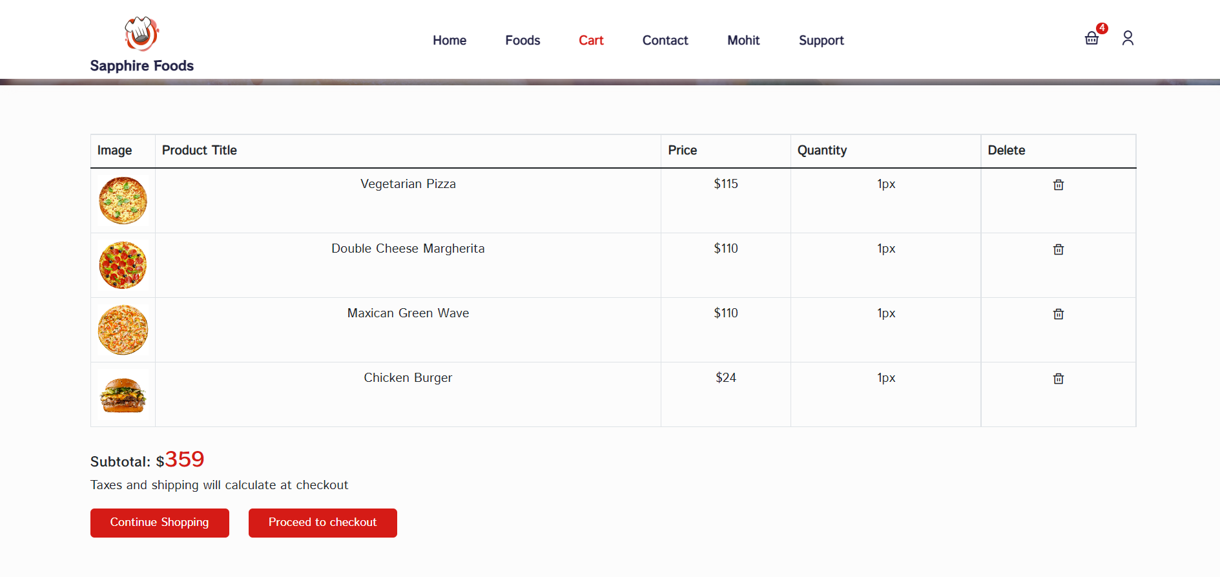

Slide 36
THANK
YOU

